Slide 1
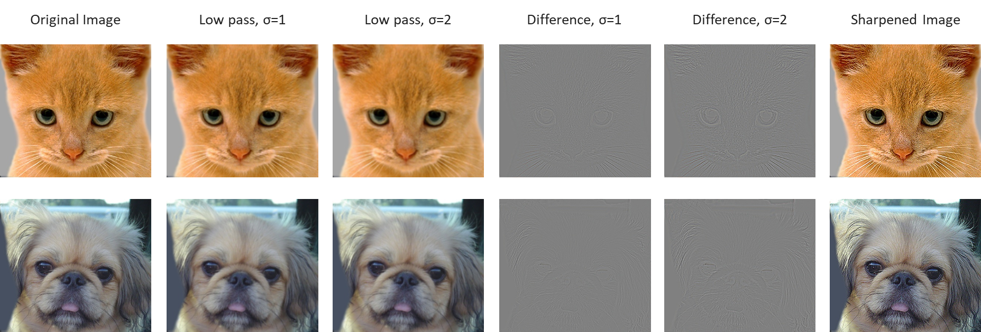
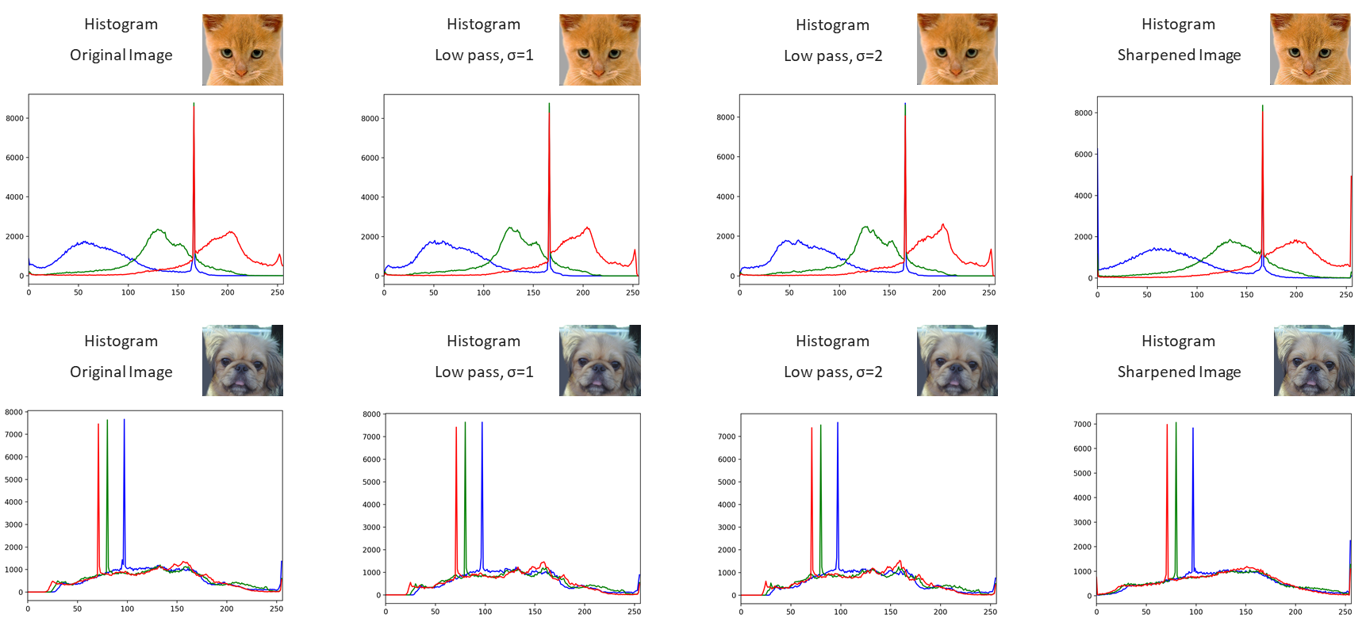
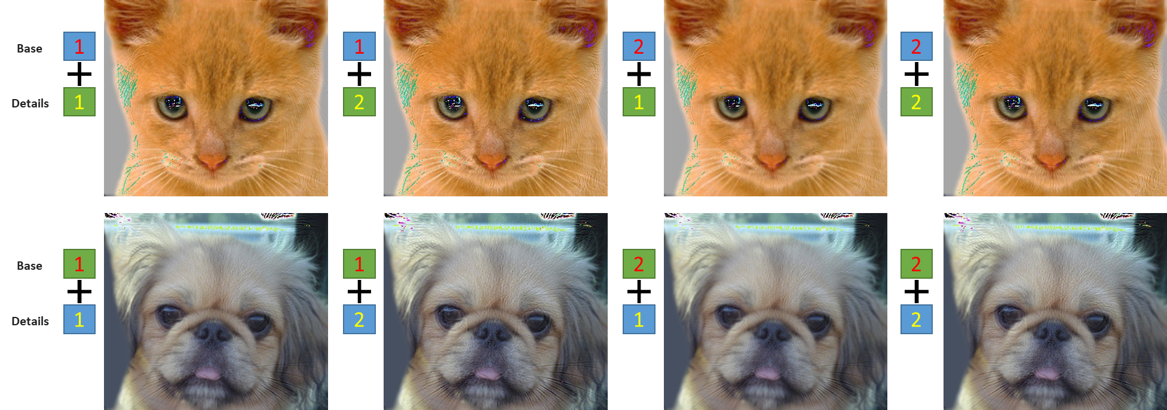


Section 1
HOMEWORK 1A
ECE/CS 8690 2302 Computer Vision
$$Hybrid Images in Python$$
Xuanbo Miao
14422044
xmiao@mail.missouri.edu
Section 2
Abstract-what I made:
Coding with python and cv2;
Visualizing a couple of images;
Low pass filter, difference, and sharpened images;
Implementing of two Gaussian filter with different σ;
Histogram of those images (R, G, and B);
Image hybrid with different σ selection and images.
Section 3

Slide 2
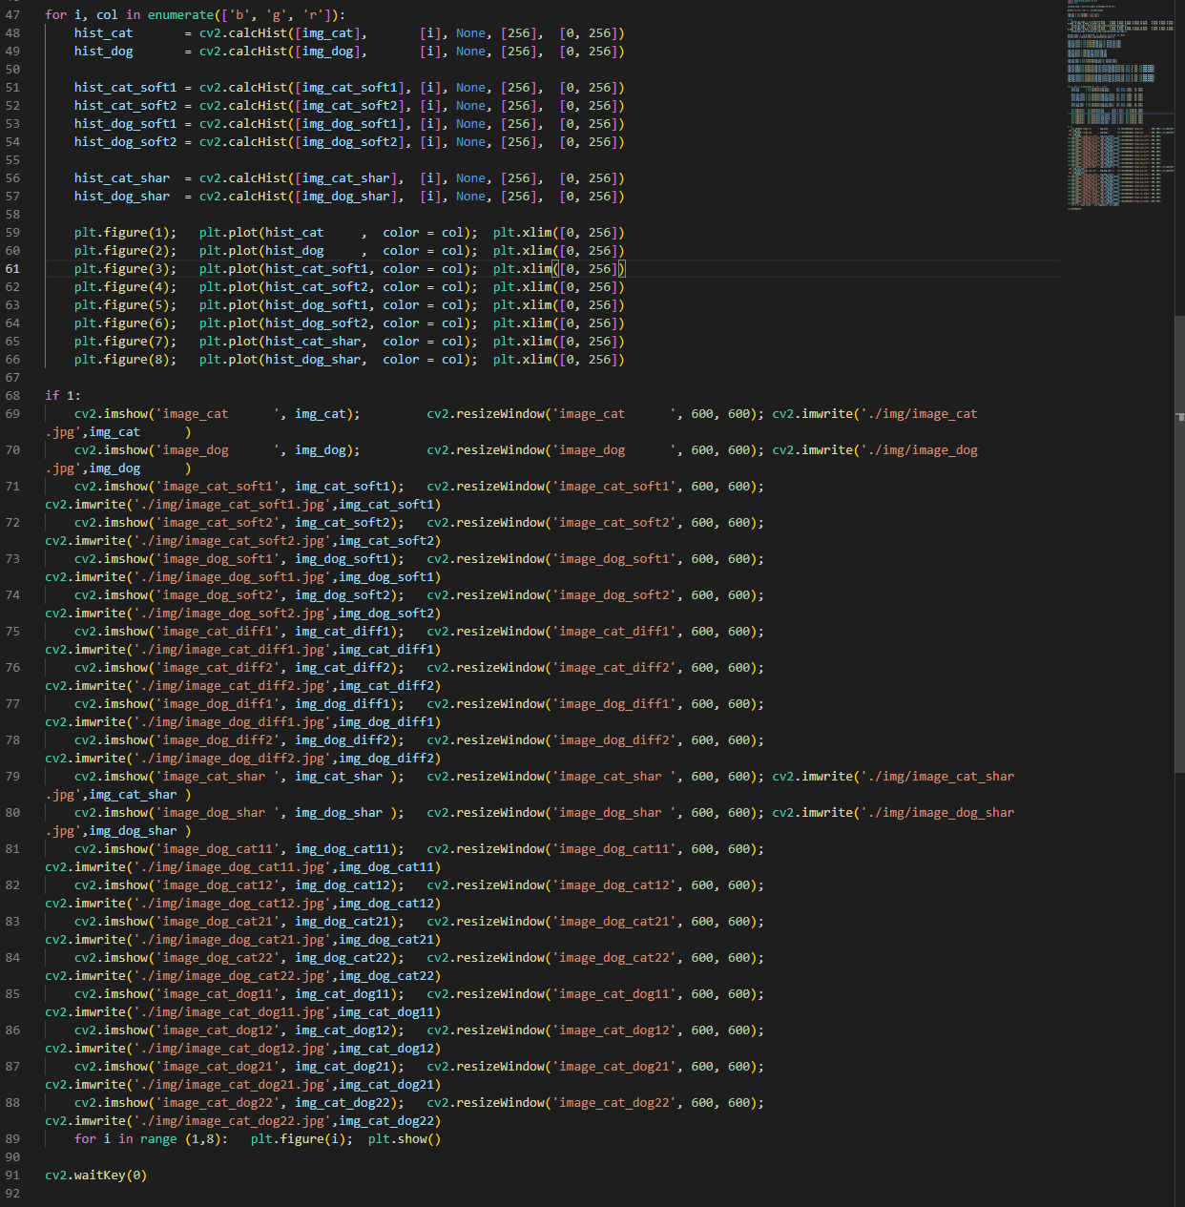
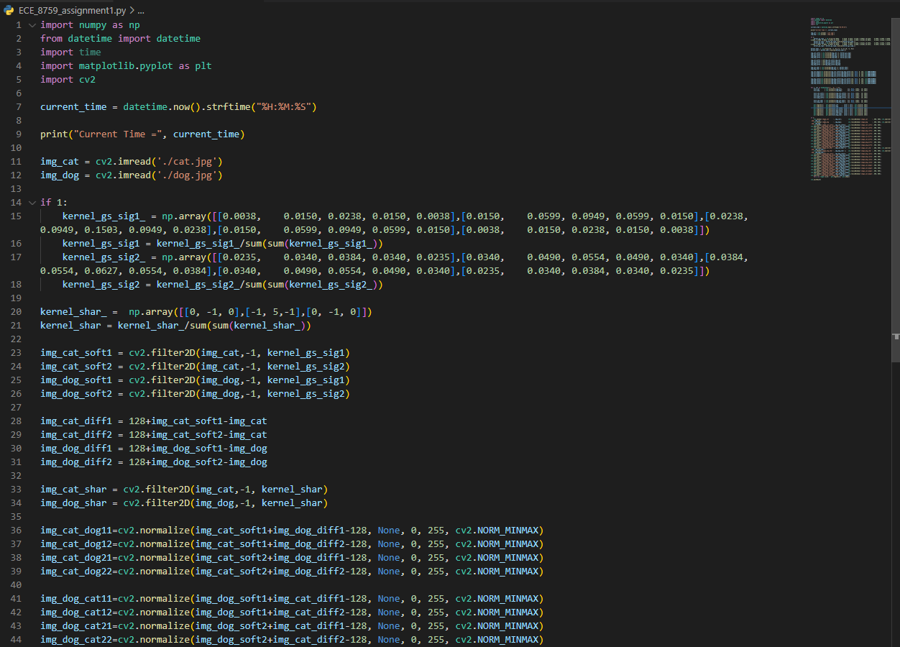
Introduction & My Code
Here we get two input images. ①We are going to implement low pass filter, show difference between original image and filtered image, and show sharpened image. ②After that, RGB-channels histograms are drawn corresponding to all these input images and their varieties. ③Then we need to compute and display hybrid images for two sigma values. ④ All those images are needed to visualize.
③
④
①
②

Slide 3
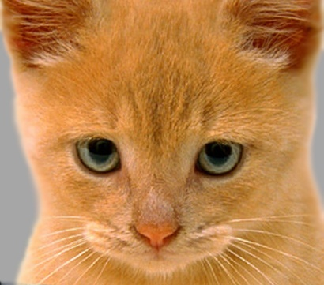


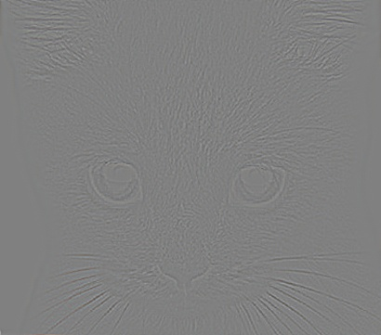
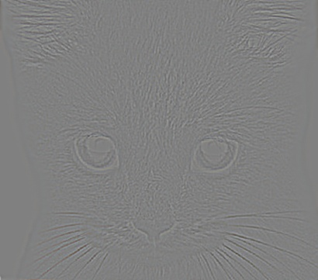

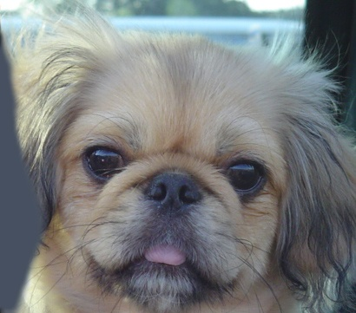

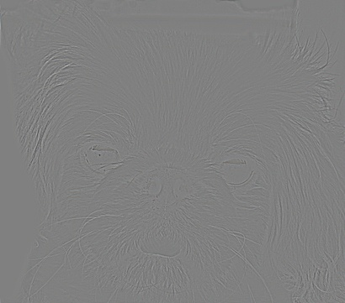
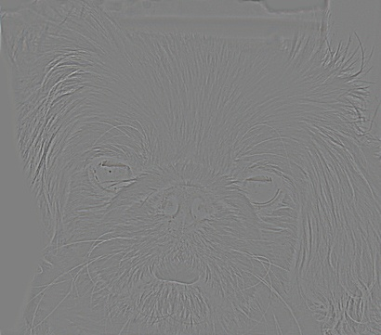

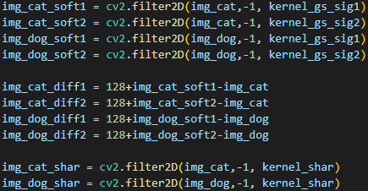
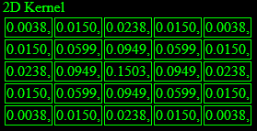
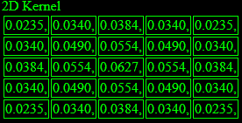
Section 1. For both input images, generate and display: (a) low pass filtered (smooth) image; (b) difference between original image and smooth image; (c) sharpened image.
Original Image
Low pass, σ=1
Low pass, σ=2
Difference, σ=1
Difference, σ=2
Sharpened Image
Gaussian Kernel, σ=1
Gaussian Kernel, σ=2
Corresponding code for generating these images

Slide 4
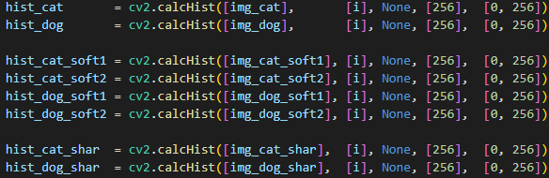
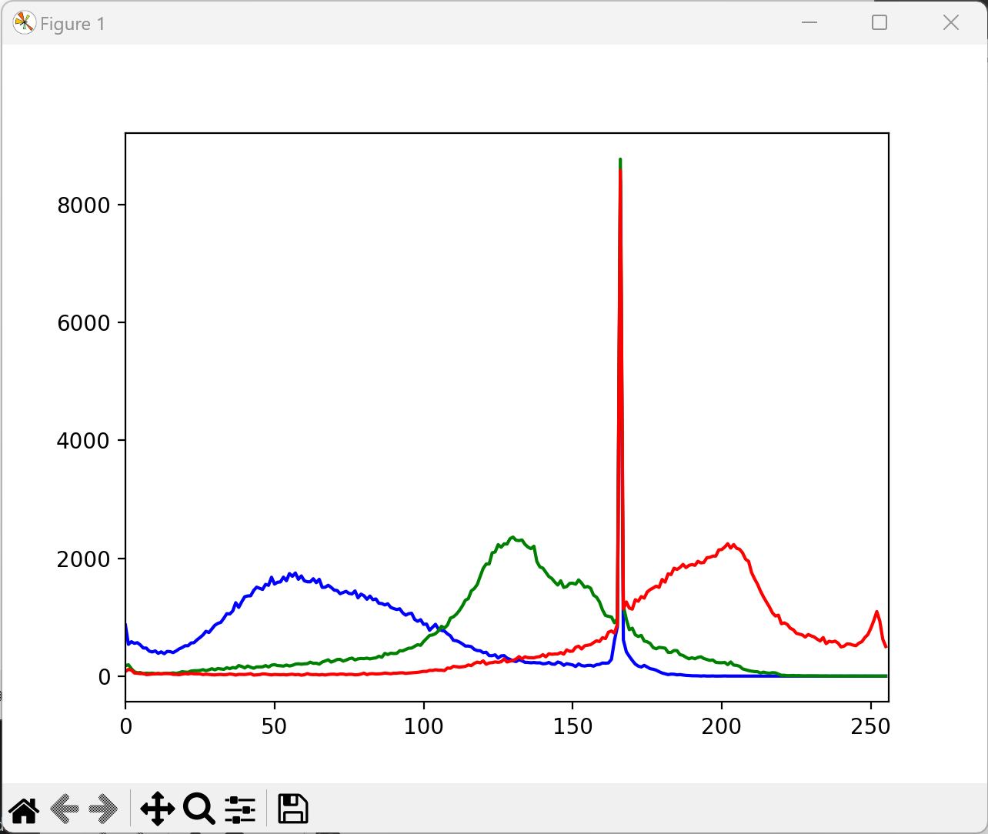
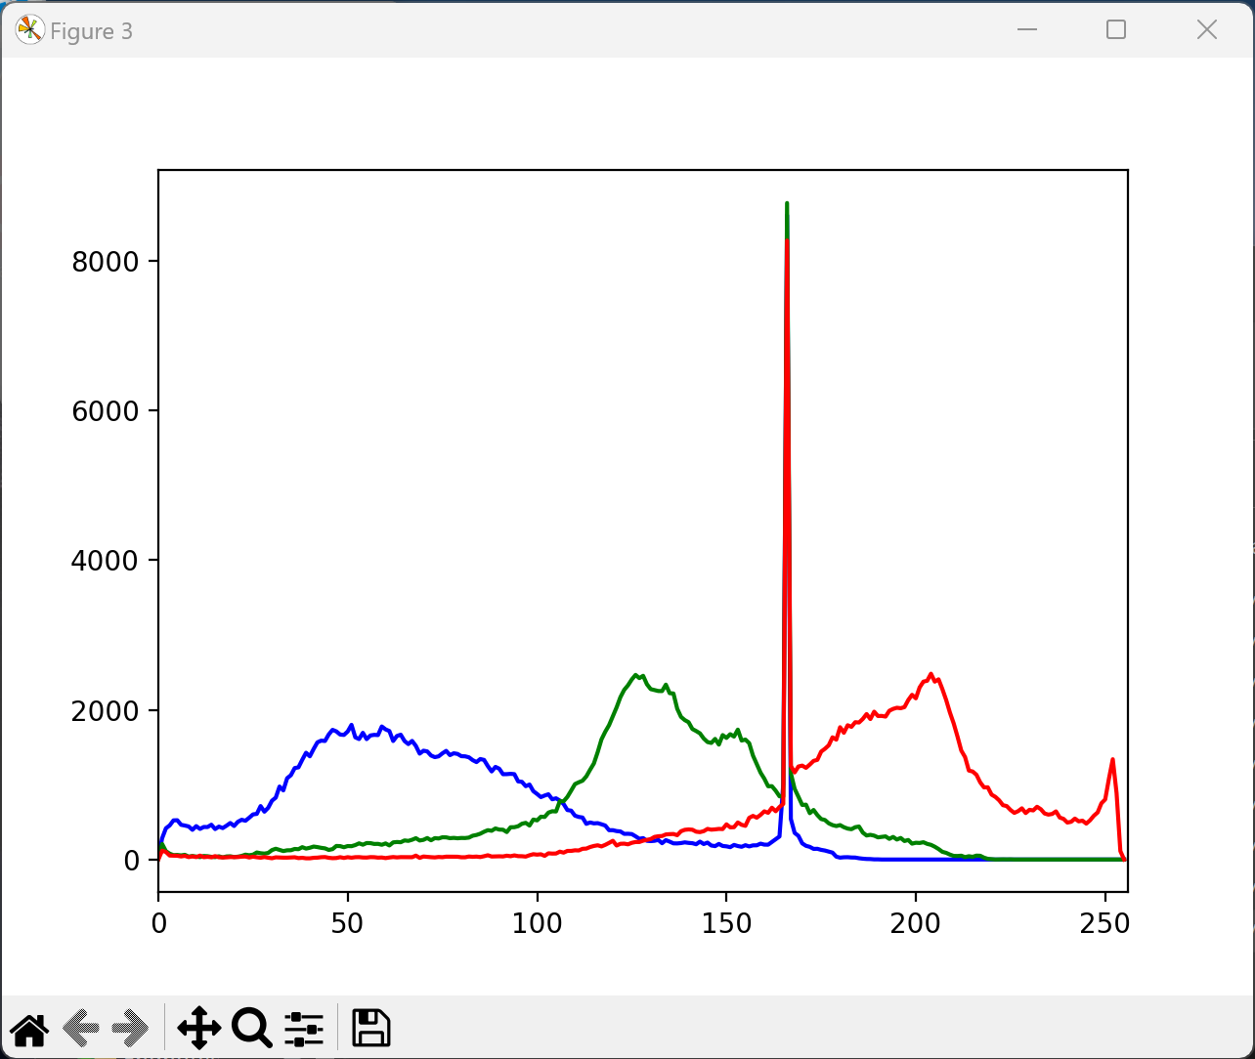
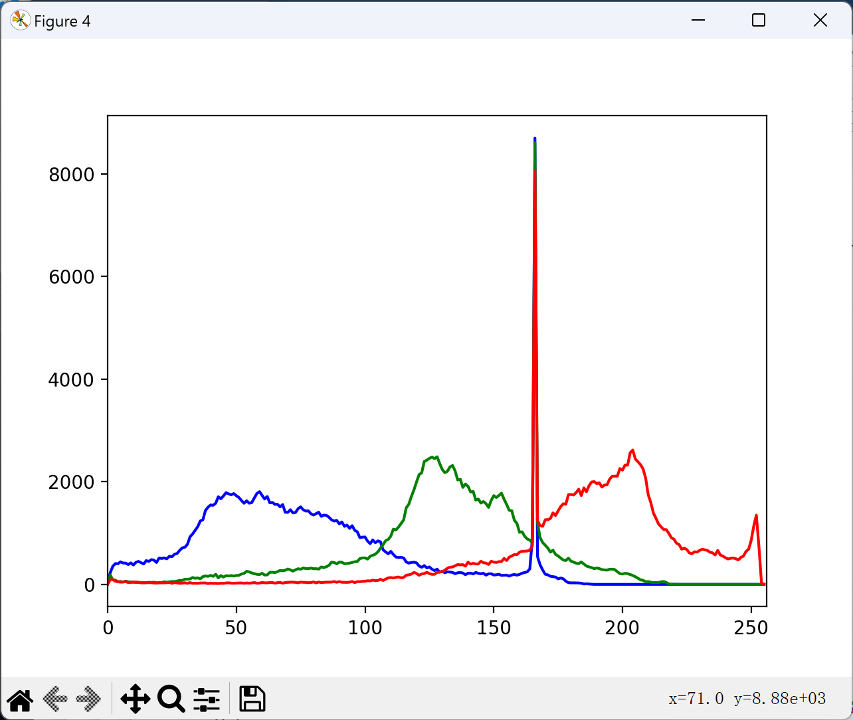
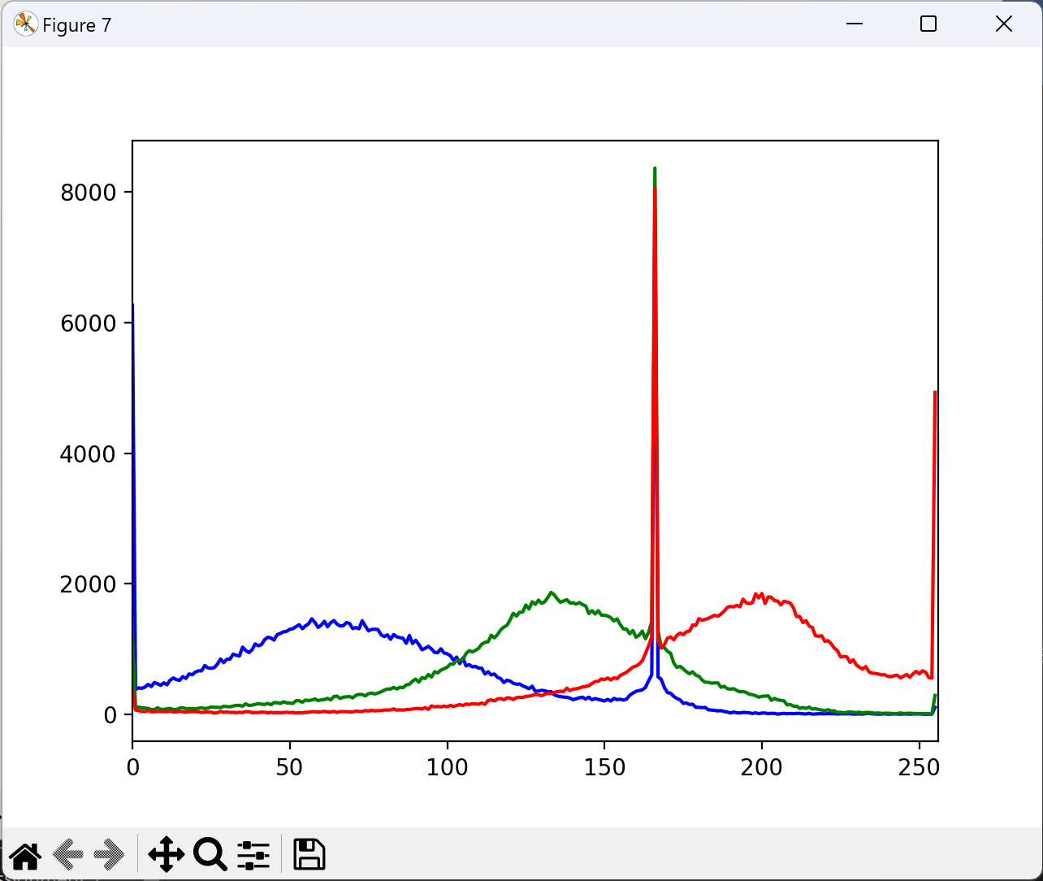
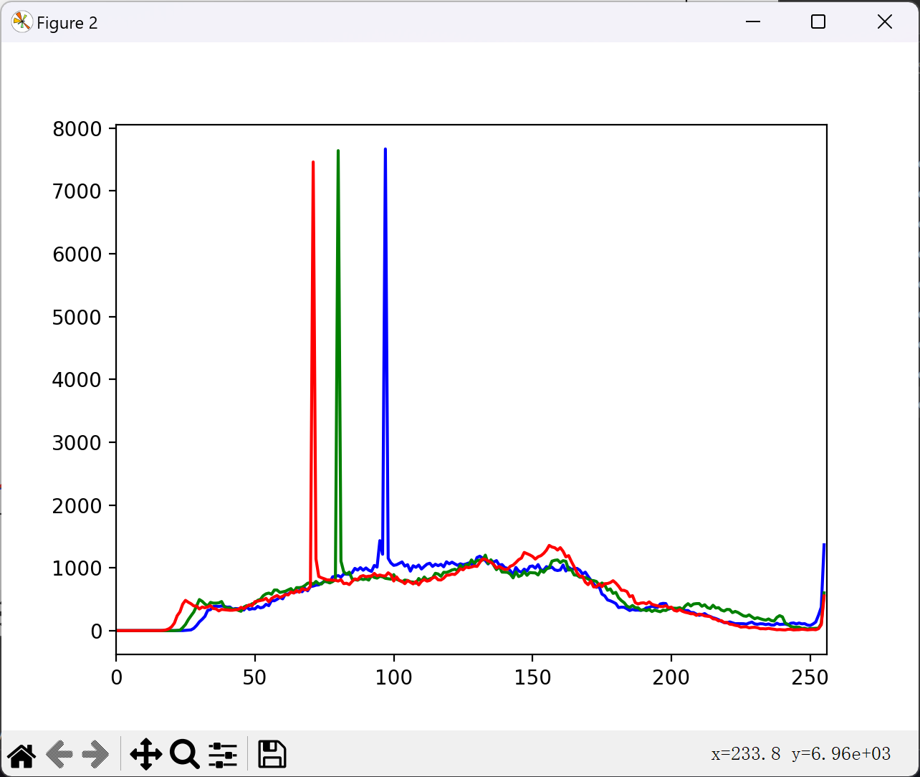
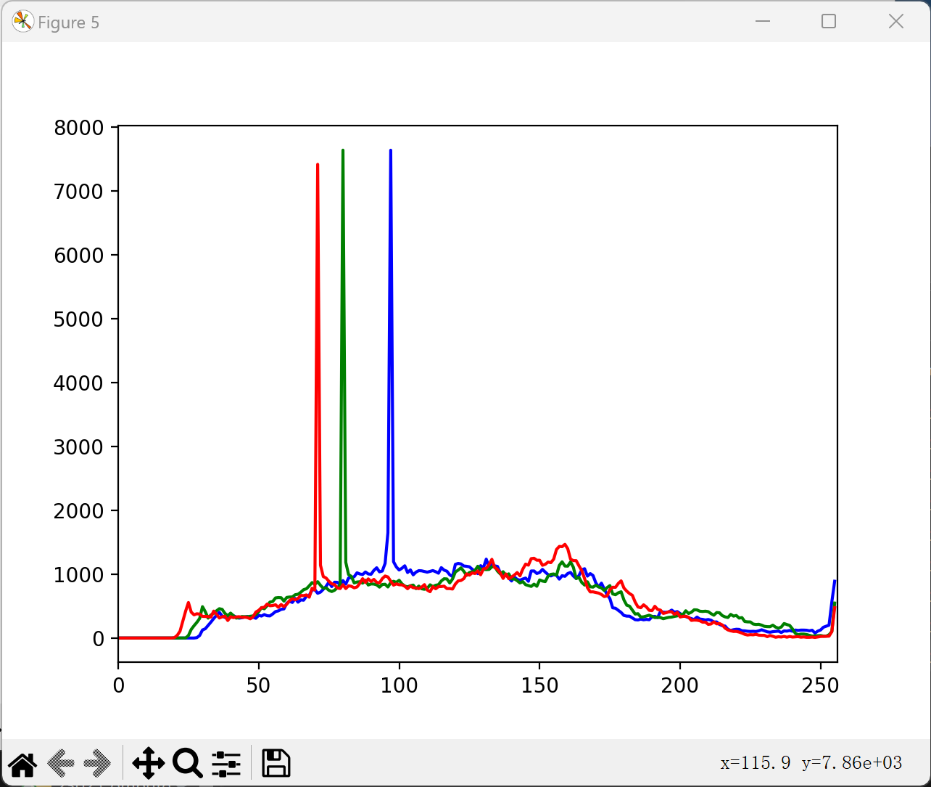
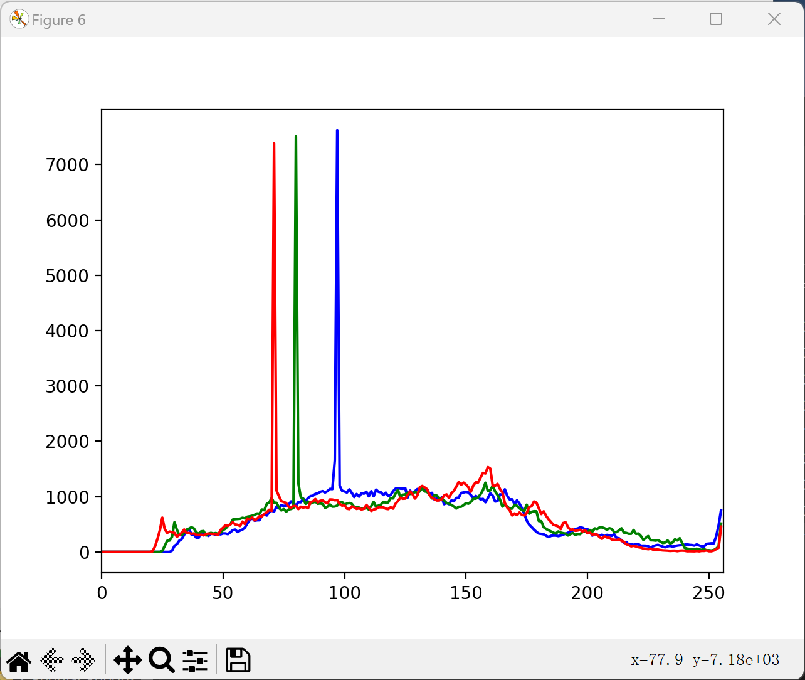
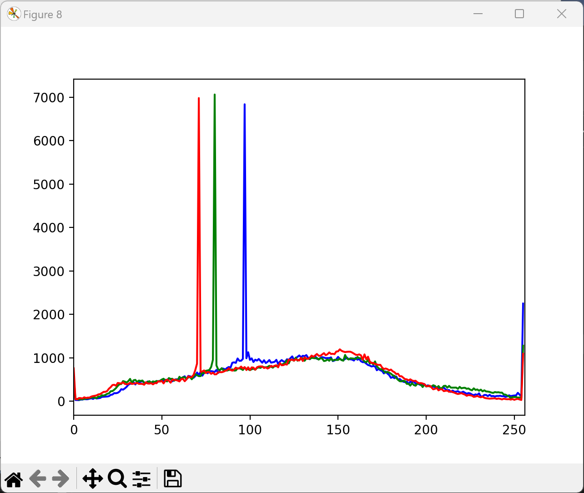
Section 2. For both input images and their smooth and sharpened versions, compute and plot red, green, blue channel histograms.
Histogram
Original Image
Histogram
Low pass, σ=1
Histogram
Low pass, σ=2
Histogram
Sharpened Image
Histogram
Original Image
Histogram
Low pass, σ=1
Histogram
Low pass, σ=2
Histogram
Sharpened Image

Slide 5
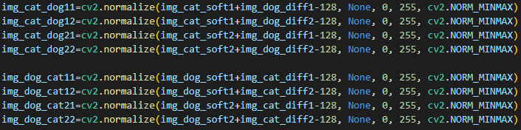
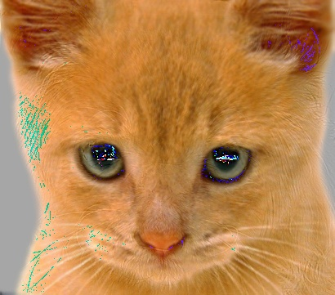
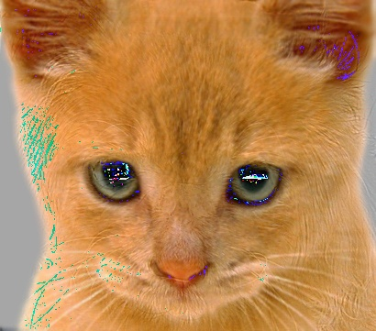


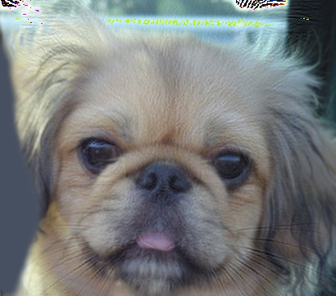



Section 3. Compute and display hybrid images for two sigma values.
1
2
1
2
1
2
1
2
Base
1
1
2
2
Details
1
2
1
2
Base
1
1
2
2
Details
1
2
1
2

Slide 6
Discussion
Section ①
① As shown in Section 1, we can see, low pass filter with higher σ will lead to more blurred images. This is also mean, if we calculate the difference of the original images and filtered images, more details will be shown on the difference images.
Actually, we get two ways to give a sharpened image. The first one is to add a difference map onto a original image. The second one is using a sharpening filter, like the one I used [0, -1, 0],[-1, 5,-1],[0, -1, 0]]. These two ways both can sharpen images.
② As shown in Section 2, the histogram is likely to be fitting well with the same corresponding original image. It worth to be noted, the details, are likely to be some kind of noise, and noise can actually flatten the histogram curves (a way to reduce color fault is by adding Gaussian noise). So, the histogram of low pass filtered images are not as flatten and smooth as the original images (and the detail added sharpened images).
③ As shown in Section 2, the hybrid images shows, the higher the σ is used on the difference image, more high frequency will be shown on the hybrid images; the lower the σ is used on the low pass base images, more overall graphic will be stayed on the hybrid images.
Section ②
Section ③

